Slide 1
Prestige and cultural evolution
Hillary L. Lenfesty
Arizona State University
4.18.2018
Notes:
[background]

Slide 2
Cultural Evolution
Cultural change via similar means as biological evolution: variation, competition/selection, & inheritance
Cultural traits = beliefs, knowledge, customs, skills, attitudes, languages

Slide 3
Cultural Transmission
Who do people decide to copy?
Conformist transmission: copy the most popular trait
vs
Prestige-based transmission: copy people of high social status (which is conferred to them by the group)

Slide 4
Dominance
Prestige
Influence via coercion and threat
Imitation by lower status only to satisfy dominant, no preferential mimicry
Expansive body displays
Aggression, egocentric
Influence via true persuasion and deferential agreement
Preferential, automatic, unconscious imitation/mimicry by lower status
Less expansive body displays
Prosocial, generous, cooperative
Notes:
Two ways of achieving status in human societies (vs one in other animals). Attributes of dominance vs prestige include:

Slide 5
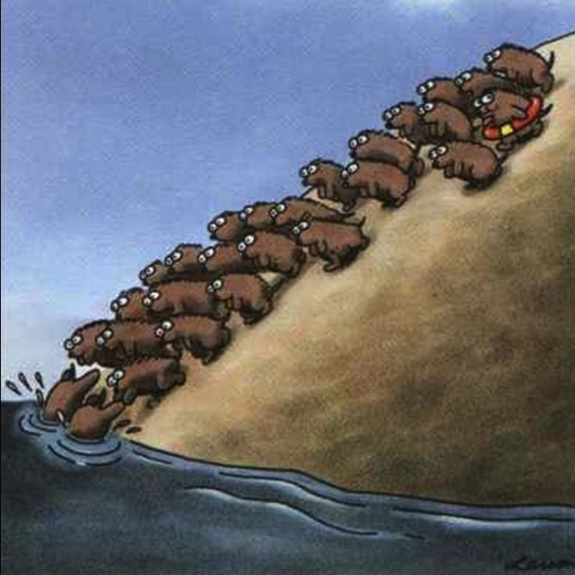
Why prestige?
Understudied, compared to other social learning biases
May help explain cultural diversity and complexity
Allows for innovations to spread

Slide 6
Modeling Prestige
Does prestige lead to the formation of groups?
Does prestige allow innovations to spread?
Notes:
100 model steps
Population size N=400

Slide 7
Modeling Prestige
Agents are evenly spaced on a torus (“donut” world) and do not move
“Prestige” is quantified by number of times an agent is copied
They are initialized with unique, random beliefs and N=1 copies per agent to start
At every step, agents update beliefs based on probabilistic copying rule (influence decays overs distance)
x = [Ncopies*e^{-dist*3}]
Probs = x/ ∑x
Notes:
100 model steps
Population size N=400

Slide 8
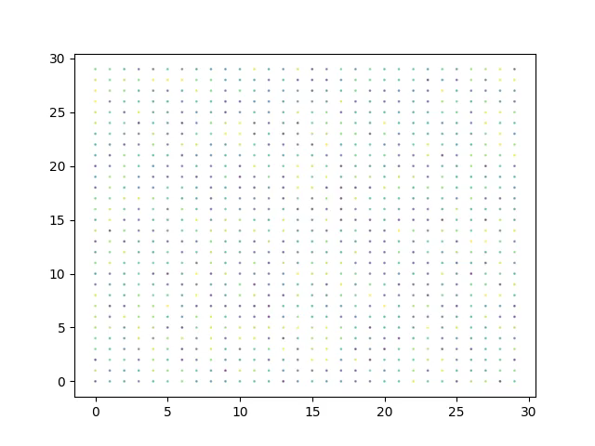
Notes:
Simulation 1:
Population = 900
Grid size: 30 x 30
200 model steps

Slide 9
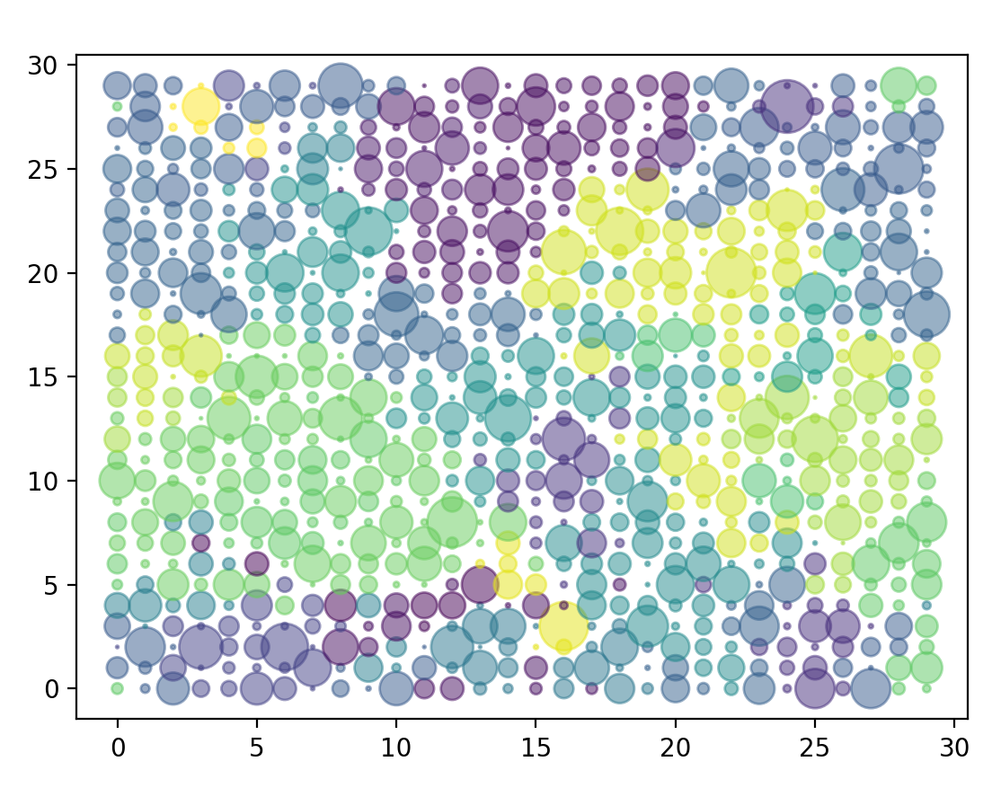
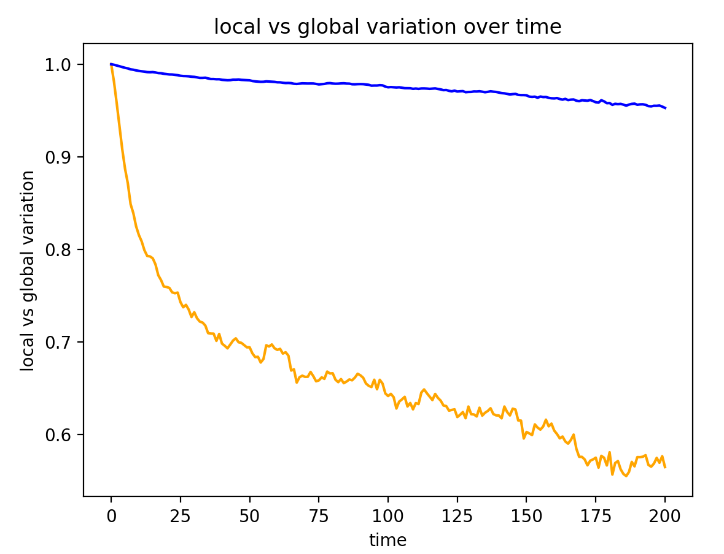

Slide 10
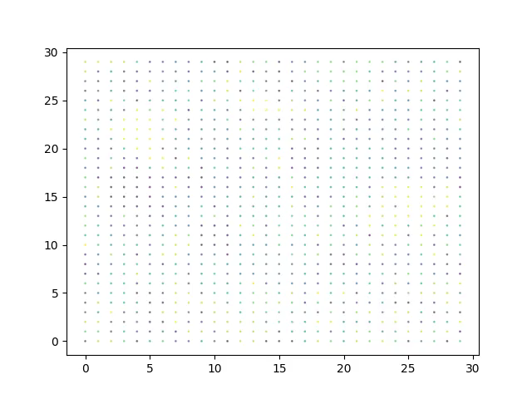
Notes:
Simulation 1:
Population = 900
Grid size: 30 x 30
200 model steps

Slide 11
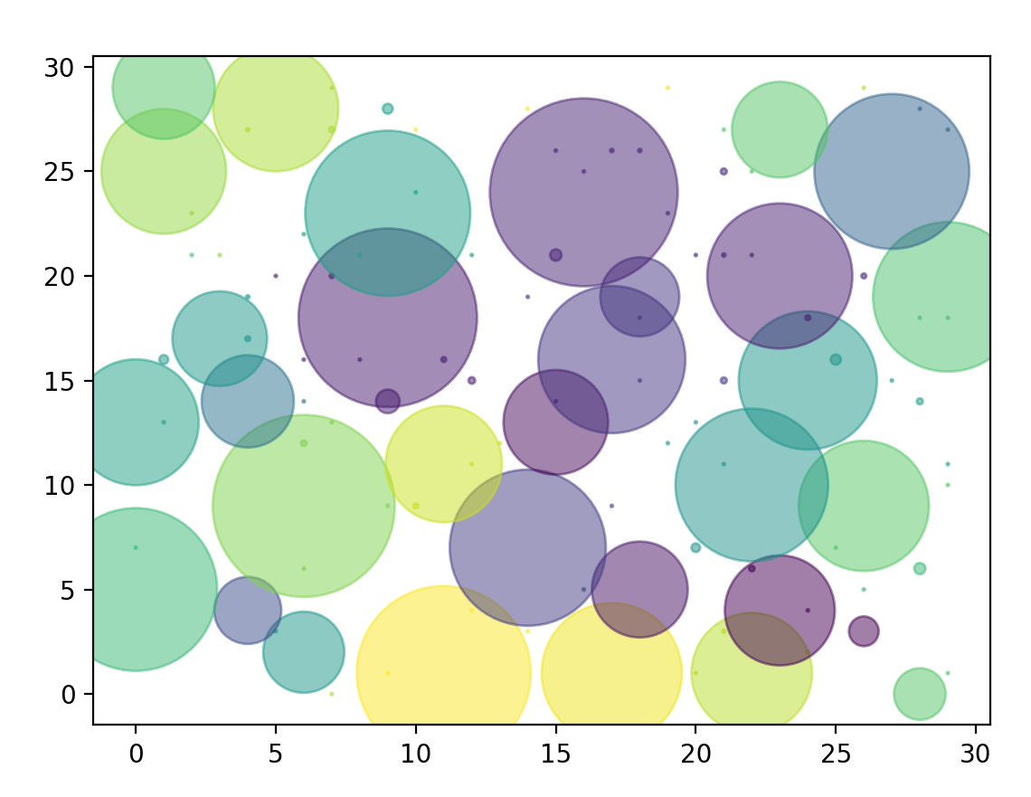
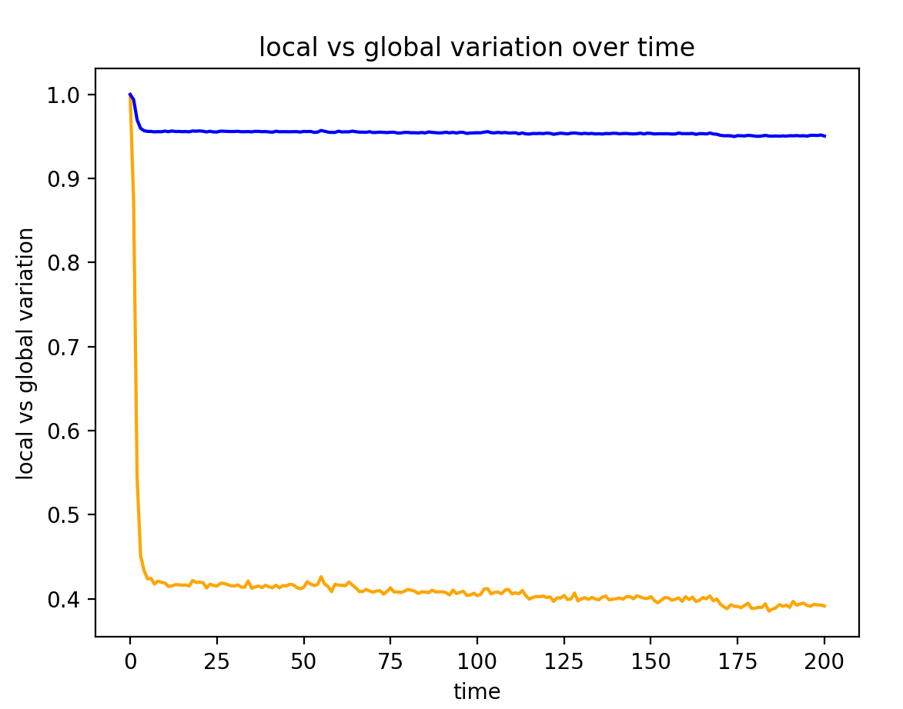

Slide 12
To do:
Introduce innovation
Explore different arrangements of agents (neighborhoods or ”villages”)
explore conditions under which prestige biased copying is favored by selection
Test empirically with dallinger

Slide 13
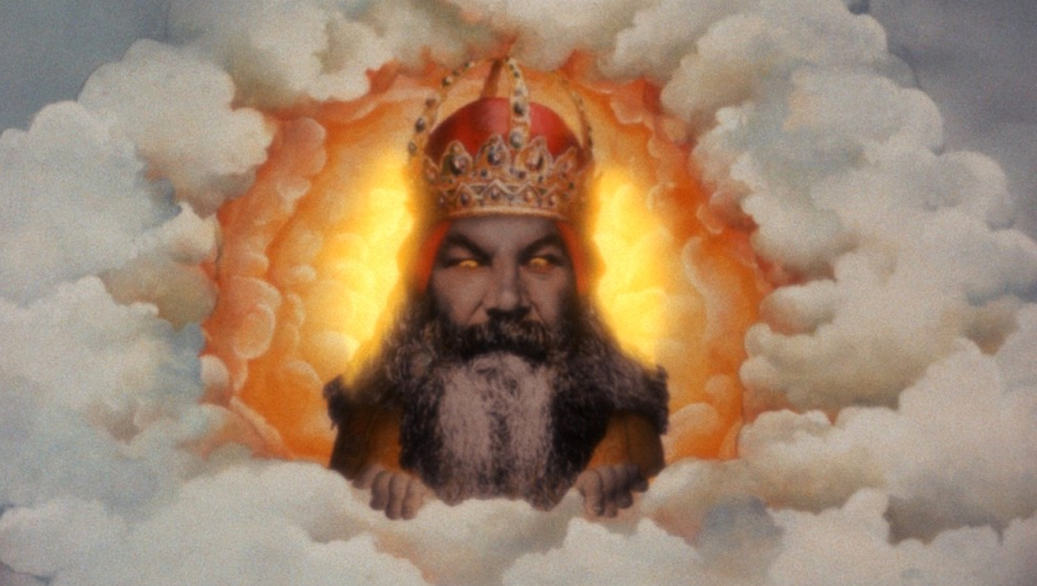
Religion, Prestige, & cultural evolution
”Big, mean” monitoring Gods promote cooperation (inhibit cheating)
A group-level, cultural adaptation
Social psych: Authoritative vs. Benevolent God concepts elicit different types of prosociality

Slide 14
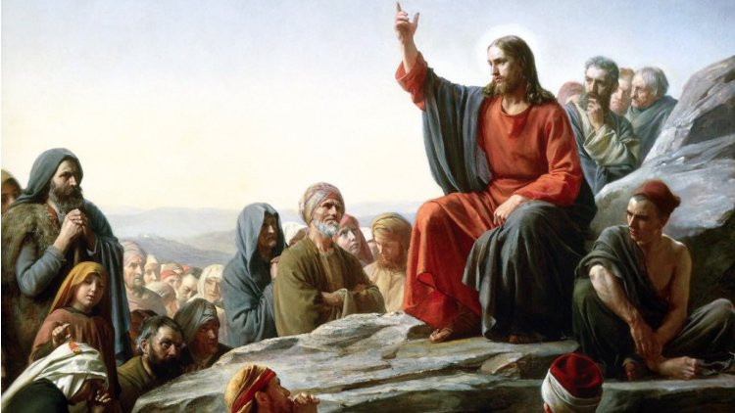
Prestigious vs. Dominant Gods
Creation of a new scale incorporating attributes of prestige
Run experiments on Dallinger testing cooperativity of different cultural groups
Physiological adaptations for prestige societies?

